Slide 1
CEREBRAL LOCALIZATION
PARIETAL LOBE SIGNS

Slide 2
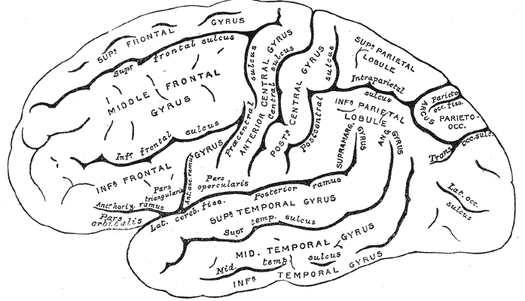
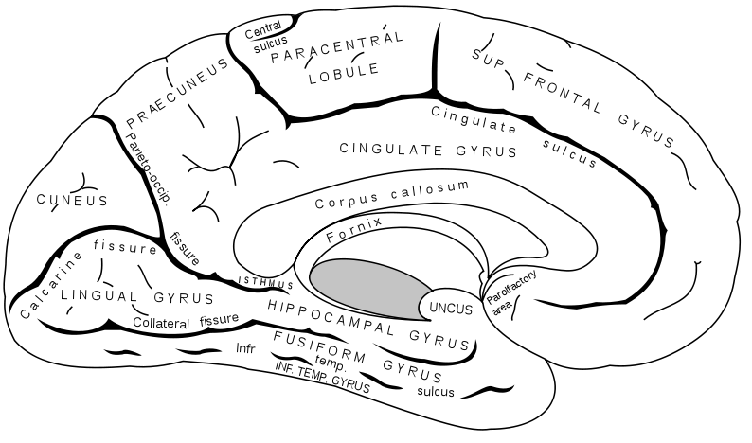
PARIETAL LOBE
File:Gray726,727.svg

Slide 3
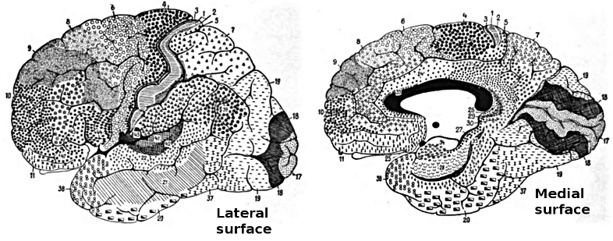
BROADMANN AREAS
wikimedia.org/wikipedia/commons/0/09

Slide 4
PARIETAL LOBE
Special high order sensory organ
Locus of transmodal ( intersensory) integration
Awareness of one’s body & its relation to extra personal space and of objects in the environment to each other.

Slide 5
LESIONS OF PARIETAL LOBE
  Post central gyrus
    Simple somatosensory disturbances
      Contra lateral sensory loss (object recognition > position sense > touch > pain and temperature, vibration); tactile extinction
      Contra lateral pain, paresthesias
  Mesial aspect (cuneus)
    Transcortical sensory aphasia? (dominant hemisphere)
    Attentional disorder

Slide 6
LESIONS OF PARIETAL LOBE
In general,
  left hemisphere is dominant for thought and reasoning, analytic and mathematical skills
  the right hemisphere is dominant for tasks requiring spatial and constructional skills, as well as for directed attention and body image

Slide 7
LESIONS OF PARIETAL LOBE
  Lateral aspect (superior and inferior parietal lobules)
    Dominant hemisphere
      Parietal apraxia (higher lesion)
      Finger agnosia
      Acalculia
      Right-left disorientation
      Literal alexia (supramarginal gyrus)
      Conduction aphasia

Slide 8
LESIONS OF PARIETAL LOBE
    Nondominant hemisphere
      Anosognosia
      Hemispatial neglect (sensory inattention)
      Constructional apraxia
      Dressing apraxia
      Loss of topographical memory
      Allesthesia
      Hemisomatognosia
      Asymbolia for pain

Slide 9
ANOSOGNOSIA
Patients fail to recognize the hemiplegic limbs as belonging to them (anosognosia)
and confabulate when asked whom they belong to (they often ascribe them to the examiner: somatoparaphrenia).
Verbally acknowledging a problem but failing to be concerned is called anosodiaphoria.
Rarely, patients may report a supernumerary phantom limb (phantom third limb or three arms) after right-hemisphere stroke.

Slide 10
      LOSS OF TOPOGRAPHICAL MEMORY
Visual or tactile localization of points in space and judgment of direction and distance are defective. Patients with right parietal lobe lesions tend to misplace the cities on a map and to get lost in familiar surroundings (loss of topographic memory)

Slide 11
ALLESTHESIA/ALLOKINESIA
When stimulated on the side contra lateral to a hemisphere lesion, patients may demonstrate allesthesia, in which they misplace the location of the stimulus to the normal side.
Patients with allokinesia respond with the wrong limb or move in the wrong direction

Slide 12
HEMISOMATOGNOSIA
Patients with parietal lesions may demonstrate hemisomatognosia, which is a unilateral misperception of one's own body. This may be conscious (the patient feels like a hemiamputee) or unconscious (the patient behaves as a hemiamputee).

Slide 13
ASYMBOLIA FOR PAIN
Patients with dominant parietal (especially supramarginal gyrus) or bilateral parietal lesions may demonstrate asymbolia for pain in which the patient does not react appropriately to pain and may indeed smile during painful stimuli

Slide 14
APRAXIA
Inability to carry out well organized voluntary movement correctly despite the fact , that motor, sensory & coordinative functions are not significantly impaired.
Pre-requisites
  Intact motor system: to execute the act.
  Intact sensorium : to understand the act.
  Pt. comprehends & attempts to co-operate.
  Pt.’s prev. skills were sufficient to perform the act.
  Organic cerebral lesion as a cause of deficit.

Slide 15
APRAXIA VS OTHER MOTOR DEFICITS
Pyramidal lesions : the paralysis precludes the act voluntarily or automatically.
Cerebellar lesions : Patient retains the ability to perform the act but not smoothly.
Basal ganglia lesions : Involuntary movements or rigidity impede the act but sequence of the act remains possible.

Slide 16
TESTING FOR APRAXIA
Common apraxias :
  Tongue apraxia : stick out your tongue
  Hand apraxia : make a fist
  Gait apraxia : walk across the room .
If verbal instruction fails, try miming.
More complicated apraxias :
  Show how to light a cigarette, hammer a nail etc.

Slide 17
TESTING FOR APRAXIA
  Limb apraxia : 3 hand test :
    1) Make a fist & tap on the table with thumb pointing upwards
    2 ) Then straighten your fingers & tap on the table with thumb upwards
    3) Then place your palm flat on the table

Slide 18
TYPES OF APRAXIA
Ideational : Patient is unable to initiate the action though understanding the command.
Ideomotor : Patient performs the task but makes errors; there is a common tendency to substitute a body part for an object, e.g. using index finger as a toothbrush rather than pretending to hold one.
[Dominant supramarginal gyrus lesions ]

Slide 19
TYPES OF APRAXIA
Constructional apraxia : Unable to draw/copy geometric figures , clock face , 5 pointed star.
[Non-dominant angular gyrus lesions ]
Dressing apraxia : patient becomes hopelessly muddled in trying to dress & undress, puts clothes wrong way round.
[ Non-dominant post. parietal lobe lesion]

Slide 20
AGNOSIA
Abnormalities of perception of sensation despite normal sensory pathways.
Can occur in all types of sensation but clinically usually affect vision, touch & body perception.
Visual & body perception are impaired in parietal lobe lesions .

Slide 21
AGNOSIA IN PARIETAL LOBE LESIONS
SENSORY:
  Asterognosis : Ask pt. to close eyes & place an object : coin,key, in his hand & ask what it is.
  Agraphaesthesia :trace letters or numbers b/w 1-10 on the skin of palm using any blunt tip, such as cap end of ballpoint pen.
AGNOSIA OF BODY SCHEME
  AKA ASOMATOGNOSIA/AUTOTOPAGNOSIA

Slide 22
AGNOSIA IN PARIETAL LOBE LESIONS
  Inability to locate, identify & orient one’s body parts.
FINGER AGNOSIA & R/L DISORIENTATION
  Ask the pt. to show index finger, ring finger..
  Ask pt. to touch right ear with left index finger.
  Cross your hands & ask which one is right.
  Interlock your fingers & ask pt. to pick out various digits.

Slide 23
AGNOSIA IN PARIETAL LOBE LESIONS
GERSTMANN’S SYNDROME
  Finger agnosia both for own & examiner’s fingers
  Acalculia
  Right-left disorientation
  Agraphia without alexia
[Dominant angular gyrus lesion]

Slide 24
AGNOSIA IN PARIETAL LOBE LESIONS
ANOSOGNOSIA
  Josef Babinski introduced this term to refer to a pt. with left hemiplegia & left sided sensory loss but ho was unaware of his neurological deficits.
  Pt. may even say that the limbs do not belong to him.
  At the other end of scale there is phenomenon – PHANTOM LIMB , seen in amputees, with retention of whole body image after removal of one member, c/o pain & paraesthesiae.

Slide 25
AGNOSIA IN PARIETAL LOBE LESIONS
LEFT SIDE HEMISPATIAL INATTENTION
  Patient ignores persons, objects or any stimuli from the affected side, fails to dress that side, fails to eat food from that half of plate.
  Testing for inattention :
    Ask to draw symmetrical figures
    LINE BISECTION TEST : Draw 20 cm line & ask pt. to bisect, he will mark it considerably to the right of center.

Slide 26
AGNOSIA IN PARIETAL LOBE LESIONS
SENSORY SUPPRESSION/EXTINCTION
  Tactile/visual/auditory inattention to simultaneous bilateral stimuli.
  Tactile: Brush cheek with wisp of cotton, one side then other side & then both sides at the same time
  Visual : Wiggle finger in pt.’s temporal field
  Auditory: Shake a bunch of keys
[ Seen in CVA, cerebral atrophic lesions, sometimes in parietal lobe tumors ]

Slide 27
PARIETAL STROKE- SENSORY SYNDROMES
The Pseudo thalamic sensory syndrome consists of a faciobrachiocrural impairment of elementary sensation (touch, pain, temperature, and vibration ) – in patients with inferior & anterior parietal stroke involving the parietal operculum, posterior insula, and, in most patients, underlying white matter.

Slide 28
PARIETAL STROKE- SENSORY SYNDROMES
The cortical sensory syndrome : consists of an isolated loss of discriminative sensation (stereognosis, graphesthesia, position sense) involving one or two parts of the body in patients with superior & posterior parietal stroke.

Slide 29
PARIETAL STROKE- SENSORY SYNDROMES
The atypical sensory syndrome : consists of a sensory loss involving all modalities of sensation in a partial distribution. Parietal lesions of varied topography are responsible for this clinical picture, which probably represents a minor variant of the two previous sensory syndromes.

Slide 30
LESIONS OF PARIETAL LOBE
Effects of unilateral disease of the parietal lobe, right or left
  Corticosensory syndrome and sensory extinction (or total hemianesthesia with large acute lesions of white matter)
  Homonymous hemianopia or inferior quadrantanopia or visual inattention
  Neglect of the opposite side of external space (far more prominent with lesions of the right parietal lobe).
  Mild hemiparesis (variable), unilateral muscular atrophy in children, hypotonia, poverty of movement, hemiataxia (all seen only occasionally)

Slide 31
LESIONS OF PARIETAL LOBE
Effects of unilateral disease of the dominant (left) parietal lobe (in right-handed and most left-handed patients) additional phenomena include
  Disorders of language (especially alexia)
  Gerstmann syndrome
  Tactile agnosia (bimanual astereognosis)
  Bilateral ideomotor and ideational apraxia

Slide 32
LESIONS OF PARIETAL LOBE
Effects of unilateral disease of the nondominant (right) parietal lobe
  Visuospatial disorders
  Topographic memory loss
  Anosognosia, dressing and constructional apraxias (these may occur with lesions of either hemisphere but more frequently and are of greater severity with lesions of the nondominant one)
  Confusion
  Tendency to keep the eyes closed, resist lid opening, and blepharospasm

Slide 33
LESIONS OF PARIETAL LOBE
Effects of bilateral disease of the parietal lobes
  Visual spatial imperception,
  Spatial disorientation
With all these parietal syndromes, if the disease is sufficiently extensive, there may be a reduction in the capacity to think clearly as well as inattentiveness and slightly impaired memory.

Slide 34
THANK YOU

